Slide 1
Basic Rules for Clean Data

Slide 2
Plan – Think Before You Type
More important than:
Formulas
Which program you use
Fancy formatting
Please, please, please, take the time to do this, even in a hectic situation.

Slide 3
Plan – Rows and Columns
Row – An observation or thing. Often a single record or a single form.
Column – A specific type of information on/about a row. A field on a form.
Rows and columns together make a table

Slide 4
Plan – Four Rules to Keep Tables Simple
One row per observation
All rows in table contain the same type of observation
Each cell only contains one piece of information
No duplicative columns (i.e. Date of First Contact, Date of Second Contact)
But what if you think you need duplicative columns?

Slide 5
Plan – When to Make a New Table for a New Information Type
Can a Victim Have More Than One? (i.e. more than one hospital form, more than one NOK phone number, more than one date of birth)
Ye
s
N
o
Make a new table
Make new column(s) in the main table or make a new table

Slide 6
Plan – Keys
If you have multiple tables, you must link them using unique ID numbers
Even if you have one table, having an ID number is a good idea

Slide 7
Tabular Data Formats
CSV
Excel
Access

Slide 8
Non-Tabular Data Formats
JSON
HTML/XML
Raw text

Slide 9
JSON
{
"colors": [
{
"color": "black",
"category": "hue",
"type": "primary",
"code": {
"rgba": [255,255,255,1],
"hex": "#000"
}
},
{
"color": "white",
"category": "value",
"code": {
"rgba": [0,0,0,1],
"hex": "#FFF"
}
}
]
}

Slide 10
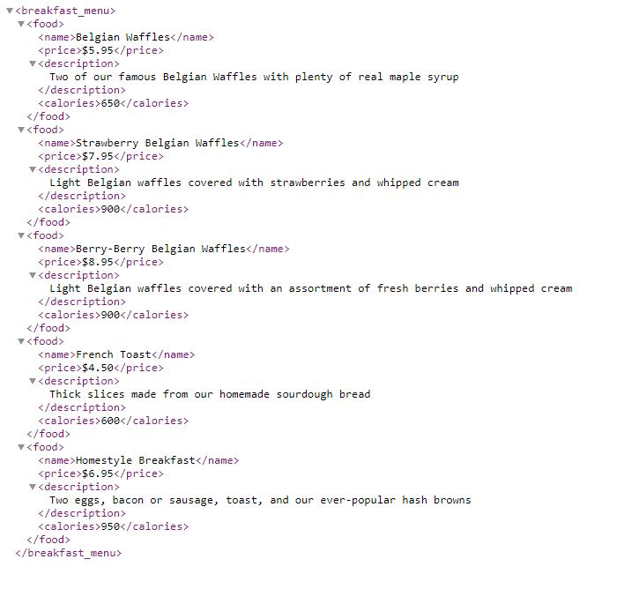
XML

